Slide 1
Live Webcast
Technology in GST
On Friday 3rd March, 2017
http://icai.estv.in/03032017/

Slide 2
Role of Technology in GST Implementation
CA. Venugopal G

Slide 3
Agenda
Role of Technology in GST
Accounting + Software in GST
Reconciliations
Transitional Challenges in IT
Other areas – IT Support

Slide 4
1. Role of Technology in GST

Slide 5
Overview
Technology or software is the backbone of GST
Success or failure of implementation of GST is heavily dependent on technology
GST will create a paradigm shift in how Small Business “run their day to day business”
Notes:
Paradigm Shift : as it requires everyone to upload their transactions which makes the entire supply chain dependent on each other & collaborate more than ever!

Slide 6
How digital India plays its role in GST?
Communication with the department is in electronic form
  Communication over e-mails - Registration till Assessments & Audit
  Notices are served in Electronic form
  Responses from assesse in Electronic form
Electronic Signatures ( DSCs / e-sign)
Mechanism of filing returns has completely changed in GST regime

Slide 7
Modes available to file returns
GST Portal >> Form Entry / Excel Utility
GST Suvidha Providers (GSPs) >> GSTN
Offline/Online Utility thru (ASPs) >> GSP>>GSTN
Tax Return Preparers (TRPs) >>ASP>>GSP>>GSTN
Notes:
GSP – An alternate portal of GST

Slide 8
2. Accounting + Software in GST

Slide 9
ERP Accounting Application
  SAP
  Oracle
  Microsoft
  RAMCO
  SAGE
  And Many other Proprietary Softwares

Slide 10
Some Accounting Applications used by- SME
  And Many other Proprietary Softwares
Desktop Application | Online Platform
Tally ERP | Quick Books
Profit | Numberz
Marg | Xero
Busy | Wave
Saral | Zoho

Slide 11
GST Implementation Challenges
Is Accounting Software a Challenge ?
Or
Accounting / Data Capturing ?

Slide 12
What changes for SMB’s day to day business?
Earlier System
GST Regime
Need not file all Sales Transactions online *
Credit is availed on basis Purchase Invoice
One Return a month / Period
All your Invoices to be filed with GST Every month
You get credit ONLY – when Vendor pays taxes and files their Monthly Returns
Minimum Three (3) Returns every month
* In some states, VAT records being filed Invoice wise
Notes:
In some states, VAT records being called for Online

Slide 13
What changes for SMB’s day to day business?
Earlier System
GST Regime
Vendor follow-up mostly for ‘C’ Forms
Multiple Law Compliance
Error – Revised Returns
Got to follow up with Vendor every Month.
Single Window Filings.
No Revised Return*
Notes:
* In the subsequent month you can edit any number of previous months data in that month return

Slide 14
Master Record Changes

Slide 15
Master Related – Chart of Accounts
Current
Tax Structure
GST
Tax Structure
Central Excise , PLA etc.
VAT / Central Sales Tax
Service Tax
Cess
Inventory
May or may not Integrated with books
CGST,SGST IGST
Separate for each state
Input; Output; Payment
Inventory
Inventory needs to be integrated in the ERP system
Basis of HSN / SAC codes
Notes:
Chart of Accounts

Slide 16
Master Related - Chart of Accounts
Current
Vendor / Customer Masters
GST
Vendor / Customer Masters
Customer / Vendor Code + Name
Address , Tax Jurisdictions
Payment Terms etc.
Taxation
Invoicing rates mostly at gross levels at end of invoice.
Point of Incidence – Tax calculation Logic for CE/VAT/ST
Existing plus GSTIN
Multiple GSTIN
Taxation
Destination based Taxation (CGST+SGST / IGST)
Line item level Rates with HSN/SAC
Notes:
Chart of Accounts

Slide 17
Transaction Changes – Sales
Notes:
Sales – Now called as Outward Supply

Slide 18
New in GST Regime : Sales / Supply
Transaction Categorization
  Customer Based
    Registered Dealer Sales (B2B) vs Retail Sales (B2C)
  B2C
    B2C large invoices(invoice value higher that 2.5 Lakhs)
    B2C Others
  Destination Based
    Inter State -IGST
    Intra State Sales – CGST + SGST
  Medium of Sales
    E-Commerce Platform
    Regular
Other Aspects
  Sales to your own Branches outside the State / different GSTIN
  Tagging of ADVANCE Receipt to Invoice
  HSN & SAC Code of item sold
Notes:
Any changes in the earlier records to be tracked additionally, since no revised returns

Slide 19
For B2B – SUPPLY
Capture all the following details in Invoice
  Additional Info
    GSTIN/UIN of buyer
    Place of supply ( Bill to & Ship to – Different States)
    Description and HSN/SAC codes of the goods and services rendered
    Is the tax paid under reverse charge
    Is Transaction through E-Commerce portal
  Regular Info
    Invoice number, date and value of invoice and taxable value
    Tax rate and amount
Notes:
– Table 5 of GSTR 1

Slide 20
B2C Invoices
B2C Invoices
Track Separately
Large Invoice
IGST > 2.5 Lacs
Others
IGST <2.5 lacs + ALL Intra State
Notes:
– Table 6 & 7 of GSTR-1

Slide 21
Branch Transfer
Old Law :This was considered as Stock Transfer earlier and NO Taxation
In GST, Stock Transfer is treated as B2B Sales
Inter State : Transfer to its own branch/warehouse located in other state
Intra State : If the Branch has separate GSTIN with in the State
Notes:
Form F

Slide 22
Branch Transfer - Accounting
Record Transaction effecting
  GST Liability in Supplier Branch
  GST Input in Recipient Branch
  Sales Accounting
    If Consolidated Books – Contra Sales and Purchases
    If Separate Set of Books – Record as Intercompany and eliminate in Consolidation
P&L Impact on Consolidation : NIL
Notes:
Additional cash out flow – Working capital management – Finance Decision

Slide 23
HSN Code
Goods HSN Code : https://www.gst.gov.in/documents/HSN.pdf
Particulars | Chapter | Heading | Sub Heading | Entry
Digits | 2 Digits | +2 Digits | +2 Digits | +2 Digits
Number | 99 | 1244 | 5224 | ~17000
Track & Report | Annual Turnover ( in Cr)
2 Digits | < 1.5
4 Digits | 1.5 -5
8 Digits | > 5
Notes:
Sections

Slide 24
Services : SAC codes
https://www.aces.gov.in/Documents/GAR_st_reverse_sept2010.pdf
http://www.cbec.gov.in/htdocs-servicetax/st-notifications/st-notifications-2012/st48-2012
The SAC is a 8 digits code starts with ‘0044’
Annual Turnover ( in Cr) | Reporting
< 1.5 | Optional
> 1.5 | Mandatory
Notes:
SAC codes under GST is only 3 digit so far, have to wait for final law.

Slide 25
ADVANCE Receipt – Invoice Mapping
Month of Advance Receipt – Pay GST
<Key Element : Document Number>
Month of Invoice – Reverse Receipt Paid Taxes, by referring <Document Number> + <Invoice Number>
Notes:
– Reporting Table 11 for Advance
- Reporting Table 12 for Reversal

Slide 26
Sales through e-commerce platform
E-Commerce operator collects
  1% of the sale amount as TCS
TCS collected can be claimed against the Output Liability
Additional Data Capture :
    GSTIN of e-commerce operator
    Merchant ID issued by e-commerce operator
Notes:
eCom Operator file GSTR 8 by 10th
Assesse –
B2B File it in Table 5 of GSTR 1 - along with GSTIN of e-com operator
B2C in table 13 Part 2 with GSTIN and merchant ID
Reconciles with GSTR 2 – Table 10(2).
c) This is Advance Cash paid and NOT Input Credit
If not the transaction comes in the e-commerce mismatch report

Slide 27
Track & Report Invoice Series – Month on Month
Series of Invoices
From Number
To Number
Total Invoices
Cancelled Invoices
Net Invoices Issued
Notes:
GSTR 1 – Table 14

Slide 28
Transaction Changes – Purchases
Notes:
Going forward will be called as “Inward Supply “

Slide 29
GST Regime : Changes
Seamless flow of credit – Reduction in cost
Vendor Management Crucial – Credit availed on time
ALL eligible Inputs/Capital goods credit eligible
  previously VAT / Service Tax are not inter allowed

Slide 30
New in GST Regime : Purchases
ITC
Auto Credit Reversal
Input tax credit availed is on
Actual basis (or)Provisional basis
Reconcile
Track Auto-reversal of input tax credits
Carry forward & Reconcile Unmatched credits
Notes:
Alternatively called as : Inward supplies
TDS credits flow to my cash ledger, so I am not sure whether it can be classified as credits

Slide 31
Additional details to be captured - Purchases
GSTIN
Import of Goods
Invoice Number, Date and value of Bill of entry, HSN/SAC
Reverse Charge
Document Number and date
Credit
Segregate
Input Goods / Services (or) Capital goods
GSTIN’s of Vendor to be captured in Tax Masters
Tax Credit segregated – ( Eligible / ineligible)
Input Tax Credit into -
Notes:
* To Match from ICE Gate Portal
Entire ITC in respect of capital goods can be availed in first year itself except for pipelines and communication tower and no depreciation to be claimed on the tax portion (Q4 of Chp 10 of FAQs dtd 21.09.2016 released by CBEC)
Sec 8(3) The Central or a State Government on the recommendation of the Council, by notification, specify categories of supply of goods and/or services the tax on which is payable on reverse charge basis. No transactions are specified as of now
Point of taxation – Earlier of
Date of the receipt of goods
Date on which the payment is made
Date immediately following 30 days(goods) or 60 days(service) from the date of issue of invoice by the supplier

Slide 32

TDS credits
Additional details to be captured (these will be auto populate in returns)
  GSTIN of deductor
  Date of payment received
  Value on which TDS deducted
Existing Information
  Number, date and value of invoice
  Taxable value
  Tax rate and amount
Assesse can download certificate Form GSTR 7A from the portal.
Notes:
46(1) a department of Government, or Local authority, or Governmental agencies, or such persons as may be notified, by Government to deduct tax of 1% from the payment made to the supplier of taxable goods and/or services, notified by Government where the total value of such supply, under a contract, <5lacs.
46(2) Amount to be paid to government within 10th of next month
46(3) Deductor shall give a certificate mentioning contract value, rate of deduction, amount deducted, amount paid to the appropriate Government with 15th of next month
46(4) If deductor fails to give certificate he shall be liable for a late fee of Rs. 100 per day (Max. 5000) from the 16th day of month until the failure is rectified
GSTR 7A will be maintained by common portal

Slide 33

TCS credits
Additional details to be captured (Not auto-populated in returns)
  GSTIN of e-commerce operator
  Merchant ID given by e-commerce operator
  Gross value of supplied through portal
  Value on which TCS collected
Existing Information
  Number, date and value of invoice
  Taxable value
  Tax rate and amount
Notes:
No details will be auto populated for TCS credit (table 10)
Provisions:
Sec 56(1) Every E-com operator not being an agent, shall collect an amount equal to 1% of the net value of taxable supplies made through it where the consideration with respect to such supplies is to be collected by the operator
"net value of taxable supplies" shall mean the aggregate value of taxable supplies of goods or services
Sec 56(6) Details of supplies furnished by the operator do not match with the corresponding details by the supplier the discrepancy shall be communicated to both persons
So its mandatory to disclose the transaction in table 13 of GSTR1

Slide 34
ISD : Input Service Distributor
Credits Received in Head Office / Central Office Distributed to other GSTIN of same PAN
  Actual Allocable (or)
  Turnover in that period
Accounting
  Corporate Office : Receive (GSTR2) & Transfer Credits(GSTR7) – Current Assets
  Branches : Receive (GSTR2) – Current Asset
Notes:
Section 190.- Credit distribution of service tax by ISD
Rules to be prescribed for manner of distribution

Slide 35
Monthly Activities Summary

Slide 36
Normal/Regular Tax Payers – Monthly Return*
GSTR-1
Upload details of outward supply on or before 10th of following month
GSTR-2A
GSTR-2
Actions of Accept, Reject or Modify has to be taken
GSTR-1A
Rejections, modifications and additions in GSTR-2 will be made available to supplier in 1A
Data will be auto populated in 2A of Recipient tax payer
Supplier has to take action by 17th
GSTR-3
Auto-populated return will be available for submission along with the payment on 20th
Additions can be made
Return needs to be filed after 10th and on or before 15th of following month
Notes:
This is the current understanding of the process, may change marginally at final law

Slide 37

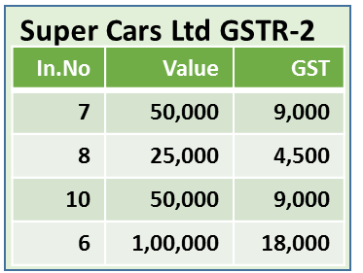
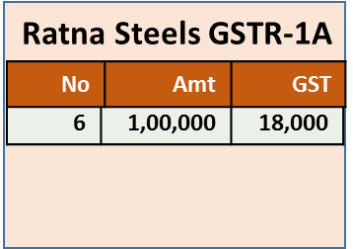
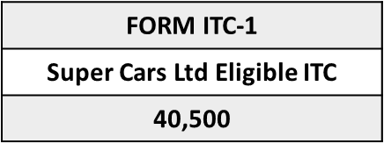
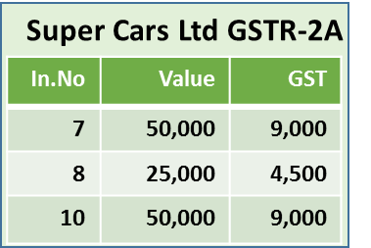
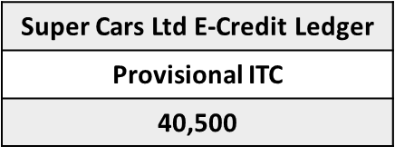
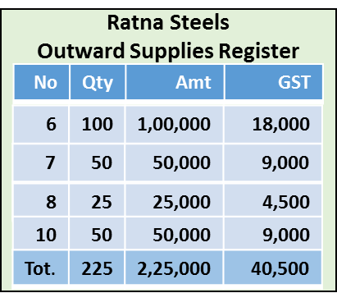
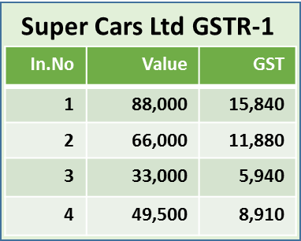
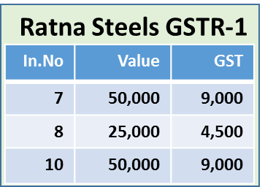
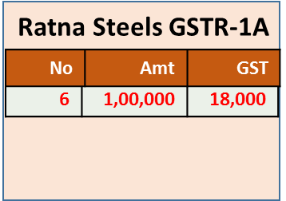
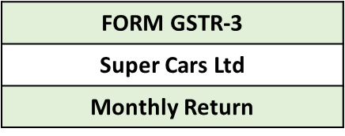
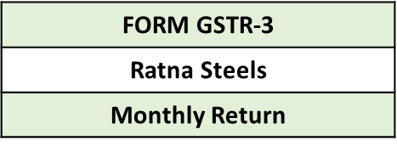

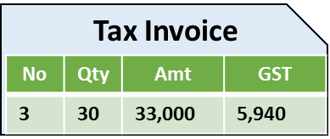
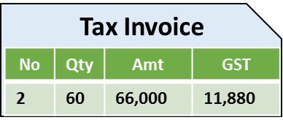
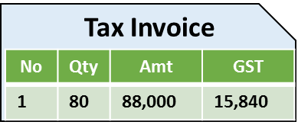

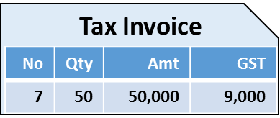

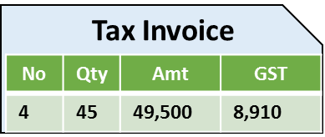

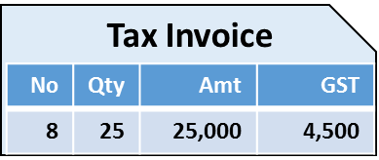

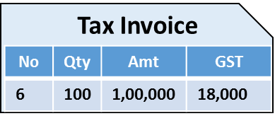
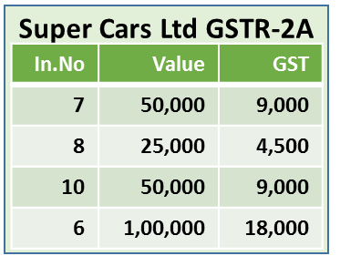


Ratna Steels Portal
Super Cars Ltd Portal
Ratna Steels GSTR-1A
In.No | Amt | GST
Ratna Steels
Outward Supplies Register
6 | 1,00,000 | 18,000
No | Qty | Amt | GST
6 | 100 | 1,00,000 | 18,000
7 | 50 | 50,000 | 9,000
Aug
Aug
Aug
Aug
Aug
Aug
8 | 25 | 25,000 | 4,500
Super Cars Ltd GSTR-1
10
21
20
11
15
16
10 | 50 | 50,000 | 9,000
Ratna Steels GSTR-1
Tot. | 225 | 2,25,000 | 40,500
6 | 1,00,000 | 18,000
Payment
Payment
Ratna steels
Super Cars Ltd
Rev Automobiles
Inward Supplies Register
Books of Super Cars Ltd for July
Outward Supplies Register
No | Qty | Amt | GST
No | Qty | Amt | GST
6 | 100 | 1,00,000 | 18,000
1 | 80 | 88,000 | 15,840
6 | 100 | 1,00,000 | 18,000
6 | 100 | 1,00,000 | 18,000
1 | 80 | 88,000 | 15,840
7 | 50 | 50,000 | 9,000
2 | 60 | 66,000 | 11,880
2 | 60 | 66,000 | 11,880
3 | 30 | 33,000 | 5,940
8 | 25 | 25,000 | 4,500
3 | 30 | 33,000 | 5,940
10 | 50 | 50,000 | 9,000
4 | 45 | 49,500 | 8,910
4 | 45 | 49,500 | 8,910
Tot. | 225 | 2,25,000 | 40,500
6 | 1,00,000 | 18,000
Tot. | 215 | 2,36,500 | 42,570

Slide 38
Errors – Technology Support
Supplier has not filed returns within due date
TDS/TCS credits not showing up
Invoice number mis-match
GST Rating
No records in 2A
Reconcile with Purchase Register
Supplier filed returns with wrong information
Reconcile with Purchase Records
Reconcile with Purchase Records
Modify 2A
Add Records in 2
Modify 2A
Record Number to be unique
Software to Support
GSTIN + Purchase Invoice Number
Track erroneous Suppliers
Track GSTR1 filing errors

Slide 39
Consolidated Monthly Return - GSTR-3
Data from GSTR-1 and 2 auto-populates to GSTR-3
Accounting software should be
  able to fetch data from the return
  auto reconcile with books of accounts
  Estimate output tax Increase / Decrease considering rectification of communicated mismatches
  Track and indicate NON RECTIFIED Mismatches

Slide 40
Determine Liability
Liabilities can be
  Return related liabilities
  Other than return related liabilities
  Software should be able to track liabilities accordingly
Liability in GSTR-3 will be discharged utilising
  ITC - Credits from Electronic Credit Ledger
  And from Electronic Cash Ledger

Slide 41
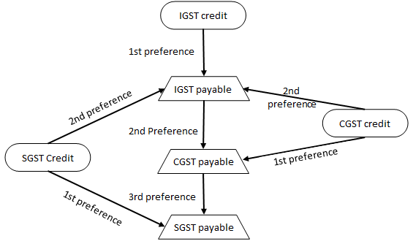
Utilize ITC
  Software must be able to track and consider restrictions on utilising credits

Slide 42
Payments in GSTR-3
Utilising ITC, Software should be able to track and report
  order of preference to utilise credits
  Provisional credits, matched credits, unmatched credits and their reversal
Utilising Cash*
  Required amount of cash has to be deposited under CGST, SGST and IGST
  Utilisation of the same can be made in GSTR-3
  *Date of utilisation from cash ledger is the date of payment

Slide 43
3. RECONCILIATIONS

Slide 44
Ledger Balance Reconciliation
Accounting Software has to provide for reconciliation of following ledgers with books of account
  Electronic cash ledger
  Electronic credit ledger and
  Tax liability register

Slide 45
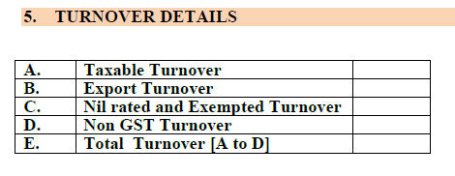
Turnover Reconciliation
Software has to have reconciliations for AUTO POPULATED Turnover filed in GSTR 1 + 1A

Slide 46
Electronic Cash Ledger

Slide 47
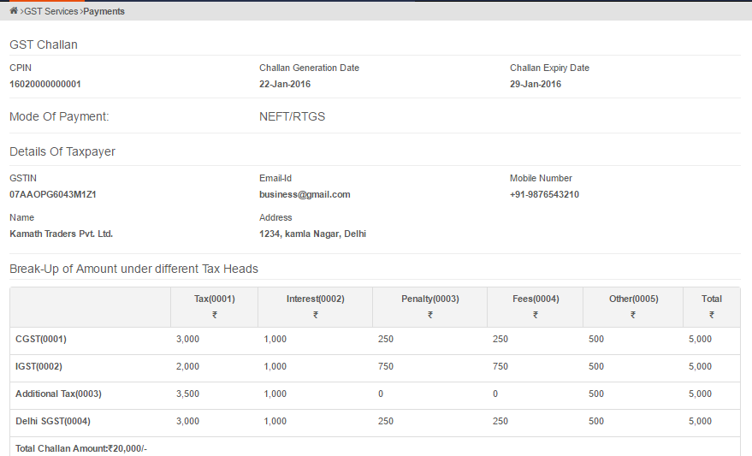
Payment Challan
Unique Common Portal
Identification Number (CPIN)
Challan generation date
Challan expiration date
Mode of payment
Total challan amount

Slide 48
Cash ledger
Cash has to be deposited under respective heads
Cross utilisation between the ledgers with respect to Taxes, Interest, Fee, Penalty is not allowed
Major Heads | Minor Heads
CGST | Interest
SGST | Penalty
IGST | Fee
Cess | Others

Slide 49
Payments – Technology Support
Electronic Cash Ledger
  is like a e-wallet
  Cash has to be deposited under relevant heads ONLY
  And it shall be utilised accordingly for discharging liability
Date of deposit is not the date of payment
Date of utilisation from cash ledger is the date of the payment
Notes:
This slide can be removed if it is a repetition

Slide 50
Electronic Credit Ledger

Slide 51
Credits - Technology Support
Software must track the credits appropriately. Credits can be
  Provisional credits
  Matched credits and
  Unmatched credits
Software must track for
  reversals of credits with appropriate reasons
Notes:
Provisional credits can be used to discharge liability of current month only
It must also provide for timely and appropriate reconciliations with credit and cash ledgers

Slide 52
Mismatch Report – GSTN Portal
Captures mismatch reported by the Supplier Taxpayer & Receiver Taxpayer
Generated for every tax period
  on filing of valid GSTR 3 by the Taxpayer (or)
  21st day of (M+1) whichever is later
Both supplier and receiver will be communicated on generation of mismatch report

Slide 53
Mismatch Report - Technology Support
Mismatch report with respect to taxable supplies will be
  Supplier mismatch
  Receiver mismatch
  E-Commerce mismatch
Accounting software to Reconcile with the GSTN issued mismatch Report - ( Section A / B / C)

Slide 54
Understanding - Mismatch Report
Section A
  Elements in the transaction reported by receiver does not match with supplier
  Addition/ modification of line items of invoices /debit notes issued by supplier, added by the receiver Taxpayer but not accepted by Supplier
  ITC can be claimed in excess than reported by supplier
Section B
  Supplier has not filed return but receiver is claiming credit
  It is a mismatch resulting in creation of output liability of receiver taxpayer due to reversal of ITC claimed by the receiver
  For which the supplier has not paid tax by not filing valid GSTR 3

Slide 55
Understanding - Mismatch Report
Section C
  Mismatch in cases where elements reported by supplier in respect of line items of an invoice/credit note
  Which results on downward modification of tax does not match with the elements reported by the receiver in GSTR 2/ISD in GSTR 6

Slide 56
4. Transitional Related Challenges

Slide 57
Tax credit – C/F : - Technology Support
Unutilized credit under current regime (ST-3, VAT 100) - Carried forward as opening balance under GST
Assessee availing exemptions like SSI, SSP and composition dealers, can take credit of those
  Lying in the stock of registered person
  Purchases made within one year of the enforcement date
  And must be in possession of the invoice copy
  Must be eligible for claiming credit under both old law and new law
Calculation of the credit(stock statement) should be attested by a practicing CA or CMA
Notes:
Only such amount that is shown as closing balance in ST-3 and VAT 100 can be brought forward

Slide 58
5. Other areas

Slide 59
Supply - Technology Support
Supply can also be characterized into
  Mixed supply &
  Composite supply
Software must be configured
  To determine the supply as mixed or composite
  To provide for tax rates to be applied accordingly for such supplies
  To adjust the stock quantity in the books accordingly (for mixed supply)
Notes:
Decreasing the quantity of multiple items (for mixed supply)

Slide 60
Job work - Technology Support
When goods/capital goods sent on Job work, control process to be:
  Have a unique reference number(URN) with the due date to return back
  Review & Report aging generated based on URNs
  Squaring up the URNs once the consignment returned to factory
Notes:
Provisions in law
The inputs and capital goods sent for Job work should be received back within 1 & 3 years respectively
If not, the credit taken along with the interest for the period utilised to be reversed
The above words of URN, squaring up are for accounting control and not required in returns
Constant eye is important because we loose the interest amount if we receive the goods after 1 year

Slide 61
Business related issues – Pricing
Earlier there were multiple taxes levied and most of them were cost
GST is being rolled out with the concept of seamless credit
Prices has to be reviewed to check the impact of the above
Any impact on margin must be actually passed on to the customers and the same is regulated by law
Re-engineering of pricing of product to be part of transition
Notes:
Sec-163 – Anti-profiteering measure

Slide 62
Business related issues – Validating creditors
Vendor selection plays crucial role, Since Utilising credits are dependant on his compliances
Non Compliance by Vendor increases
  Working capital
  Product Cost
  Reconciliation & Manual efforts on Follow-up
  Reduction in GST Ratings
Rating for every supplier are based on timely compliances & mismatches

Slide 63
Information Security
All data of business will be online, it is necessary to ensure software and system has adequate security
Ensure all terms and conditions are read while entering into a contract with GSPs/ASPs/TRPs
Ensure appropriate anti-malware's and antivirus software's are installed
Be aware of social engineering attempts
Ensure key information like user IDs and passwords are adequately secured
If any unauthorised account activity are suspected, appropriate security measures to be initiated

Slide 64
ERP Changes - Summary

Slide 65
ERP Review
Modify ERP
Vendor Master
Customer Master
Tax Master
Invoice Patterns
Purchase Order master

Slide 66
ERP Review
Master Data
  Updating vendor
  customer details
    invoice structure etc..
Transaction Data
  Data Points for Filing Return
  Inventory Tracking
  Credit Matching
Registers/Reports
  Maintenance of records such as CGST, SGST/IGST registers.
  Maintain state wise CGST & SGST
GSTN Interface
  Provision for interface with GST network for filing returns & reconciliation

Slide 67
GST READINESS CHECK

Slide 68
Technology related GST Readiness
Has applicable Provisions of the law configured in Software
Is the team trained and aware of the Act & Use of Software
Your Vendors are Educated and Tax compliant
Do you have Customers GSTIN for B2B Supplies
Do you have Vendors GSTIN for B2B Supplies
Is the Rate mapping, Product Mapping HSN code complete
Auto accounting of Stock movements & Credits for the Branch Transfer considered

Slide 69
GST Readiness Contd….
Your Chart of Accounts/Accounting Entries / Notes updated
Sufficient staff + Software Reports to reconcile and communicate with Vendor/Customer on Mis-match Reports
Software to generate State wise GSTR returns
ISD – Accounting & Auto Distribution of Credits
Ability to assess revises Sale Price of your Goods
Reconcile & Report Correctness of Returns filed.

Slide 70

Thank You
For any Clarification, Please Contact
Indirect Taxes Committee of ICAI
Email: idtc@icai.in, Website: www.idtc.icai.org
© Indirect Taxes Committee, ICAI

